Slide 1
Java Class
Day 9

Slide 2





Jul
Aug
TOEIC(7/24) 6/6~7/11
TEPS(7/16) 6/29~7/12
TOEIC(8/07) 6/20~7/25
TOEIC(8/21) 7/ 4 ~ 8/ 8
TEPS (8/06) 6/20~7/17
TEPS (8/20) 7/ 4 ~7/31
Big Data Analyst(10/1)
8/29~9/2
ADsP(8.28) 8/1~8/5
www.toeic.co.kr
www.teps.or.kr
www.dataq.or.kr
austin.sogang.ac.kr
austiny.snu.ac.kr

Slide 3
Mon
Tue
Wed
Thu
1. Main
Fri
1. Recap Sub
2. Main
2.
3. Main
3.
4. Main
4.
LUNCH
LUNCH
5. Sub
5. Recap Main
6. Sub
6.
7. Sub
7.
8. Recap, Test
8. Test
Jul
Aug
Java Basic
HTML, CSS, JS
Java Intermediate
Database

Slide 4

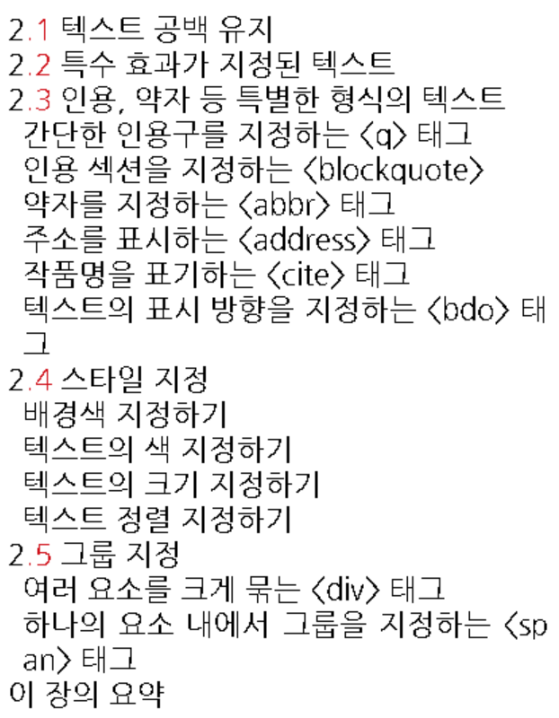
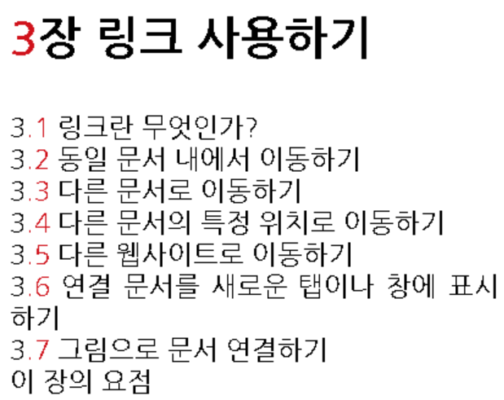
HTML

Slide 5
Java
12 Interface & Annotation
12.1 Interface
12.1.1 Basic
12.1.2 Advance
12.2 Annotation
12.2.1 Basic
12.2.2 Advance
12.3 Exam

Slide 6
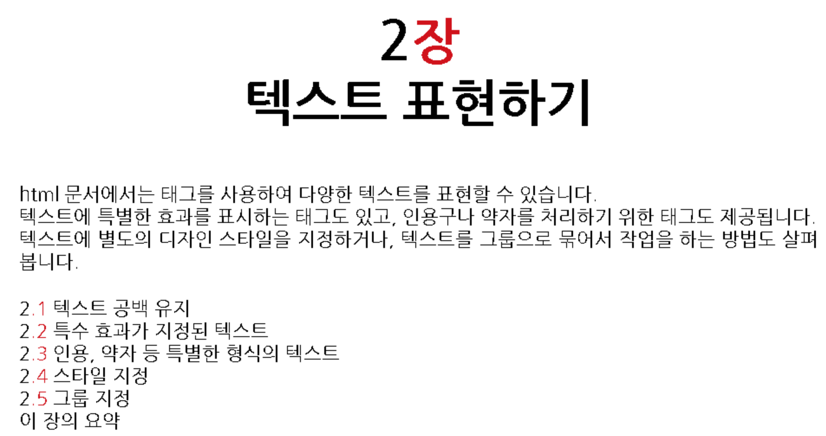

Slide 7
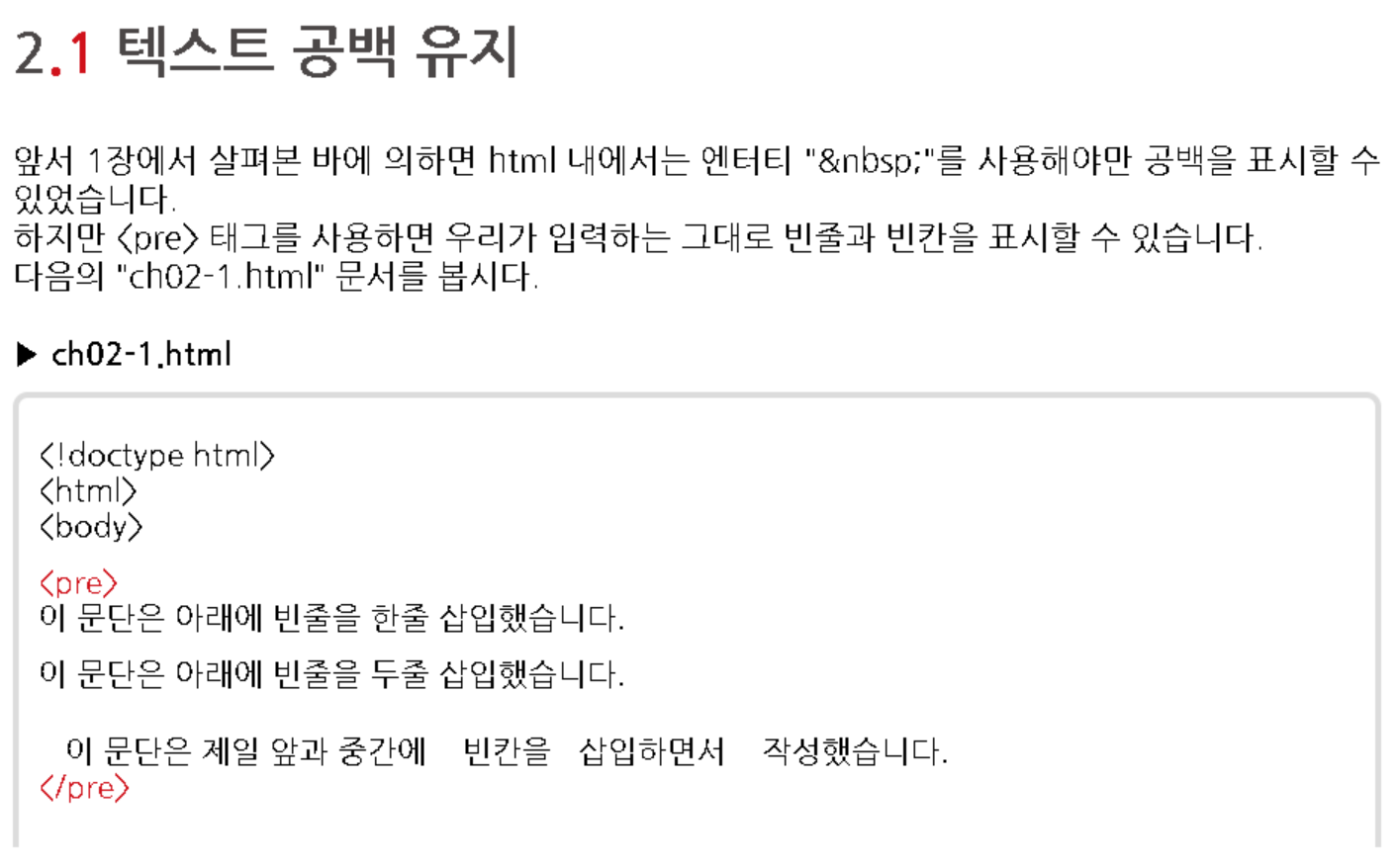
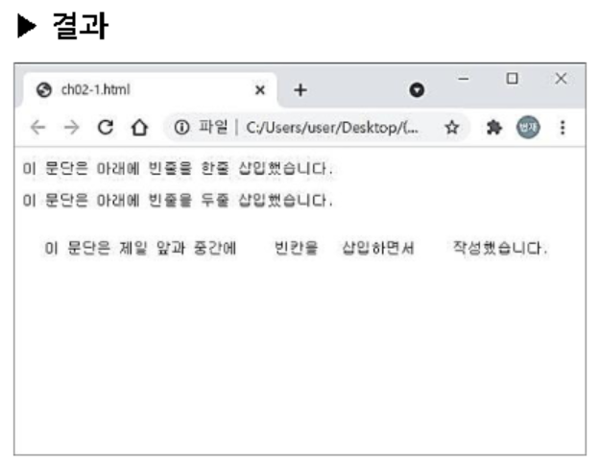

Slide 8
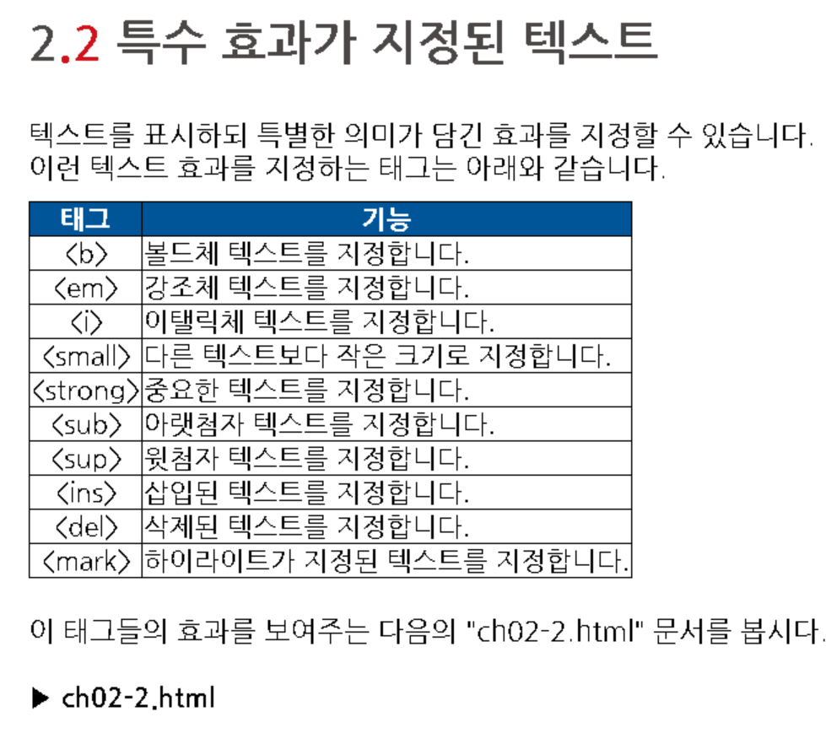

Slide 9
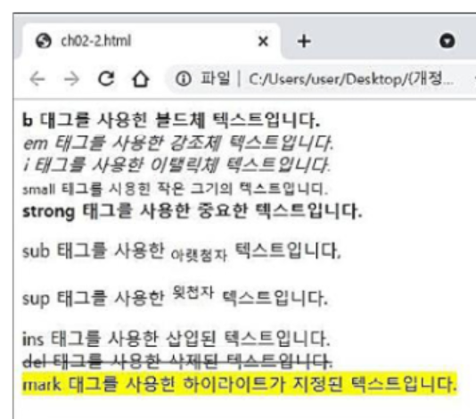
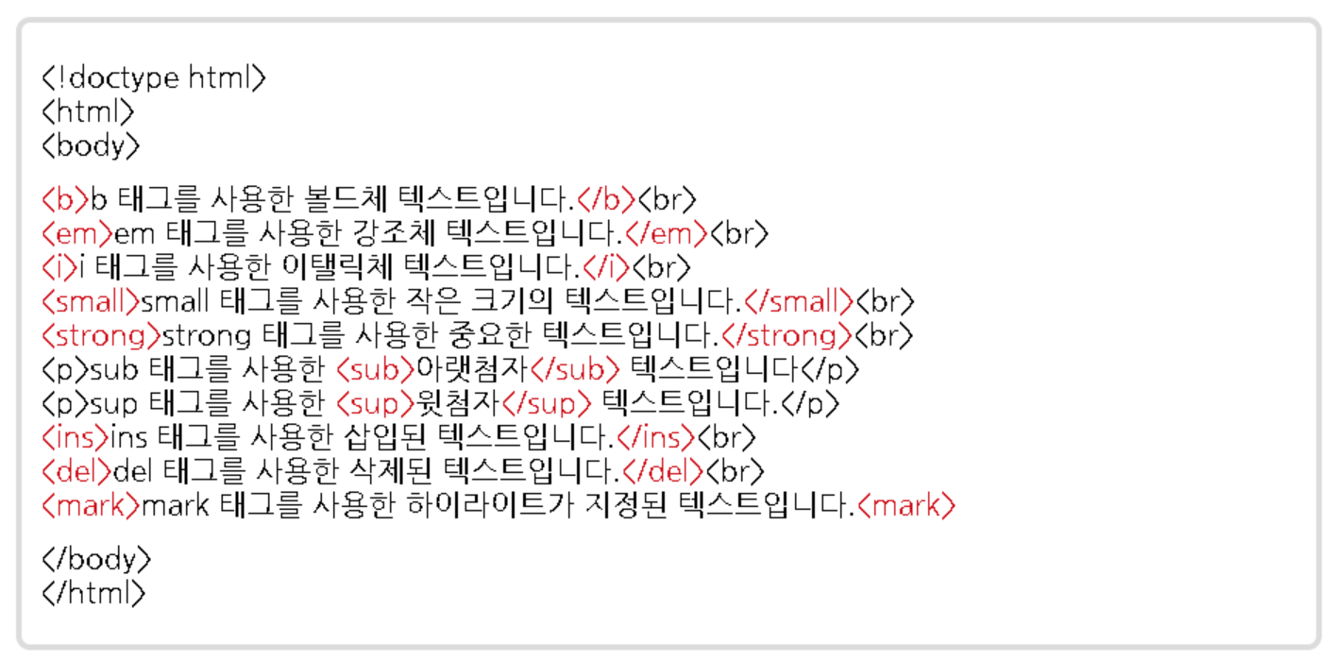

Slide 10
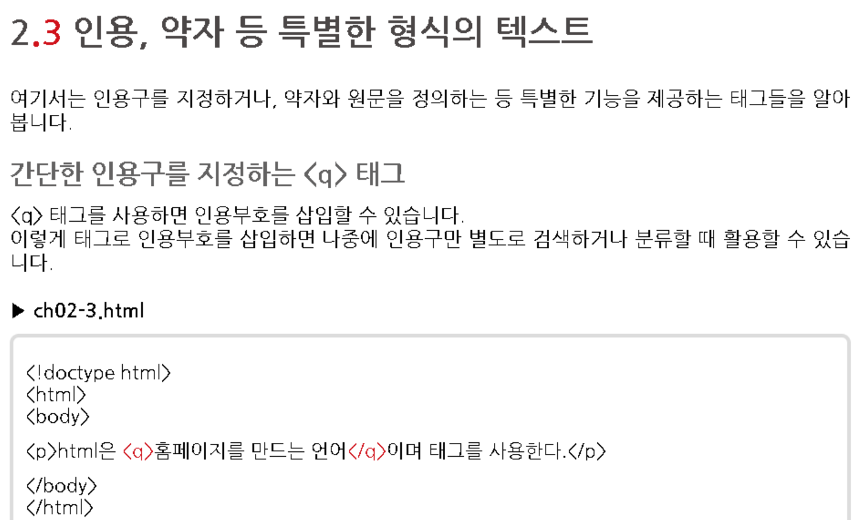
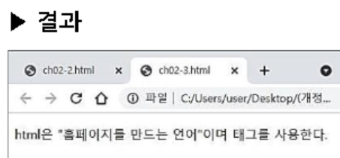

Slide 11
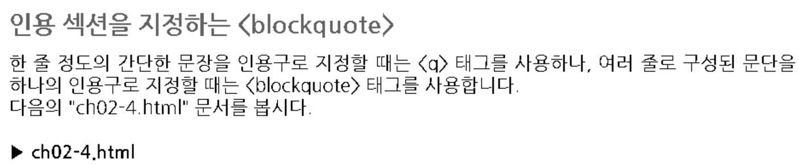
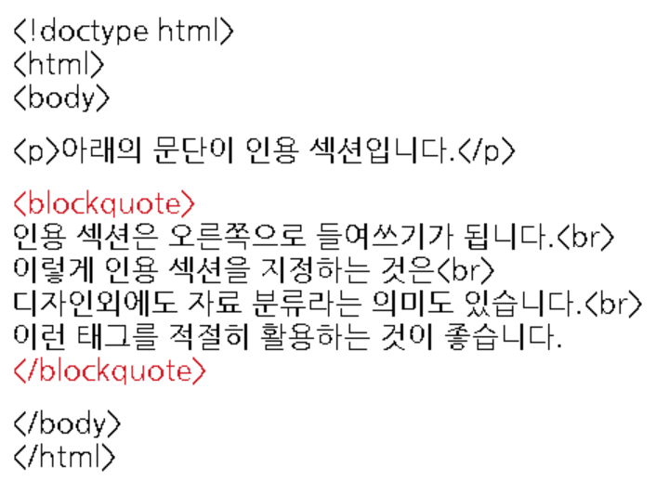
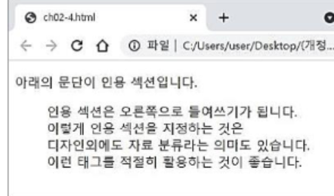

Slide 12
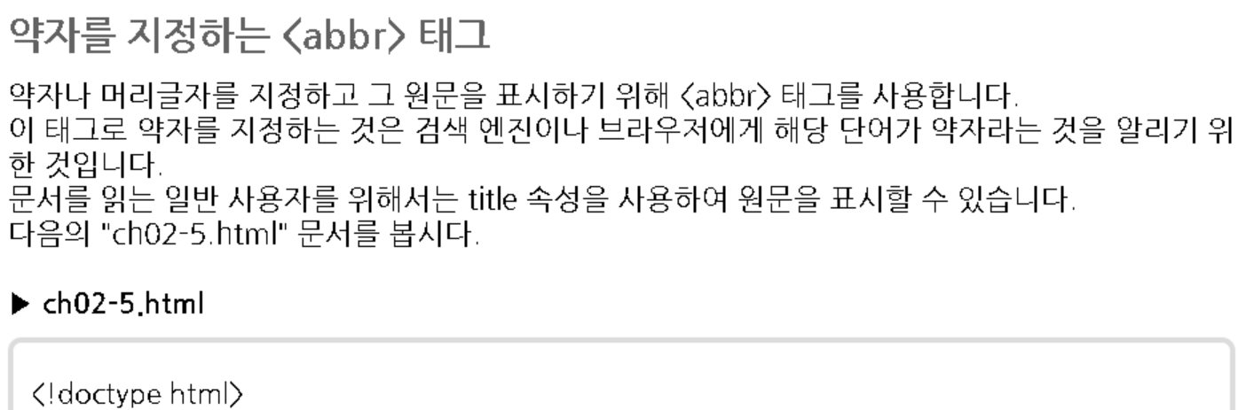
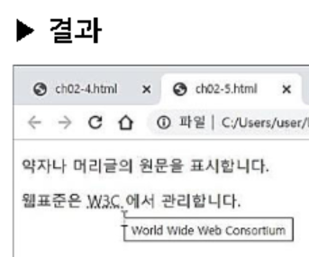
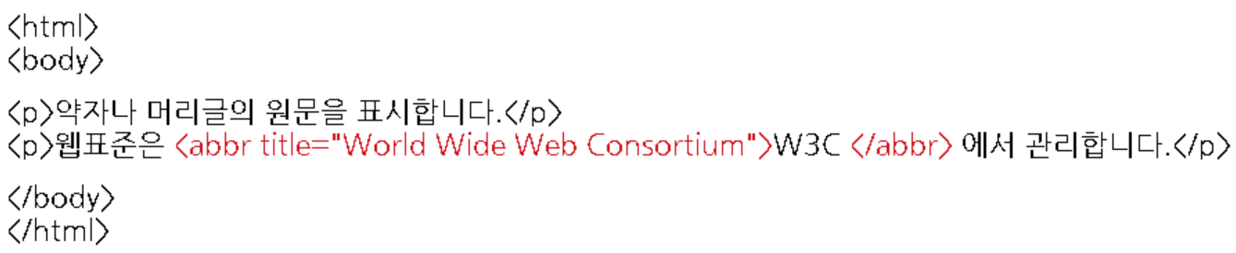

Slide 13
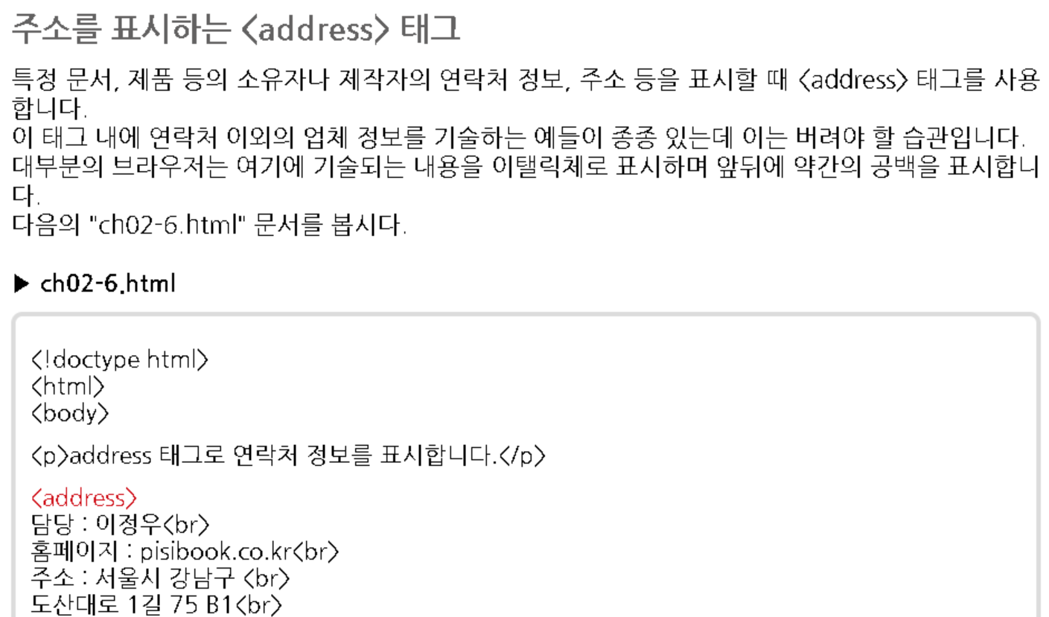
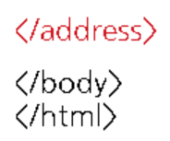

Slide 14
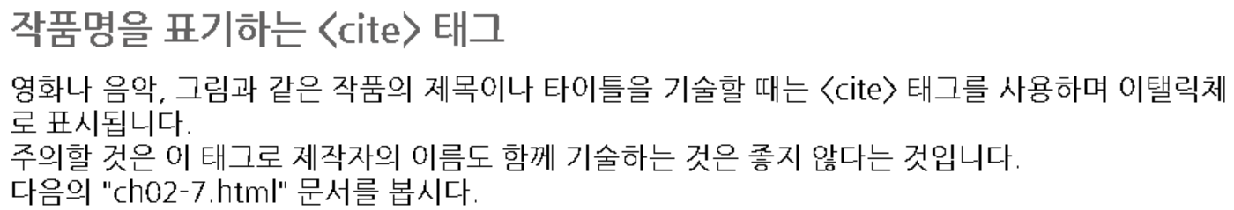
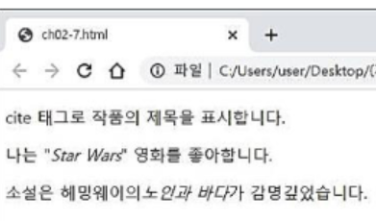
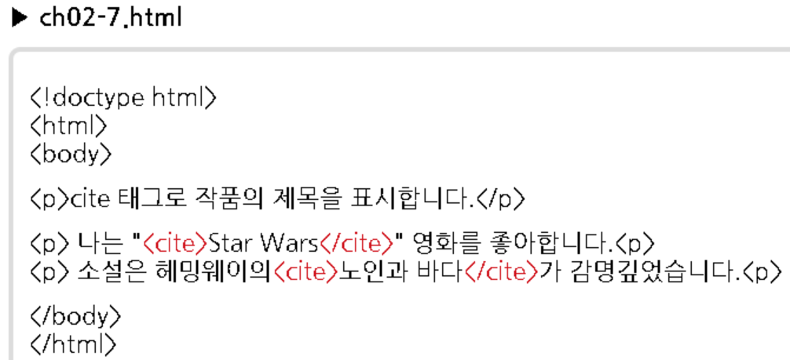

Slide 15
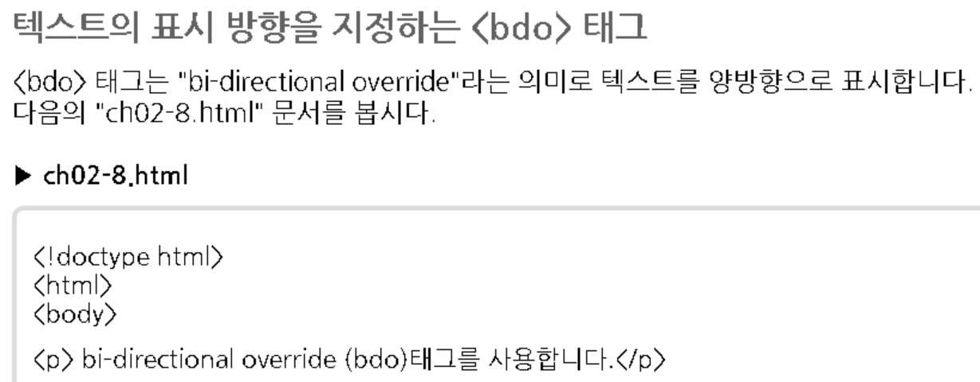
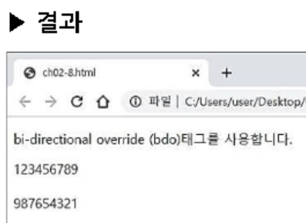
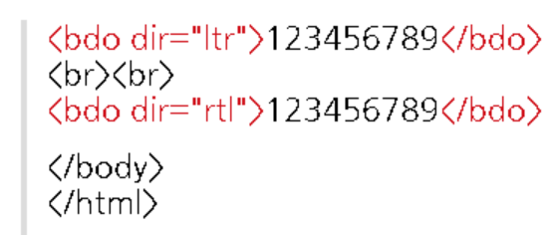

Slide 16
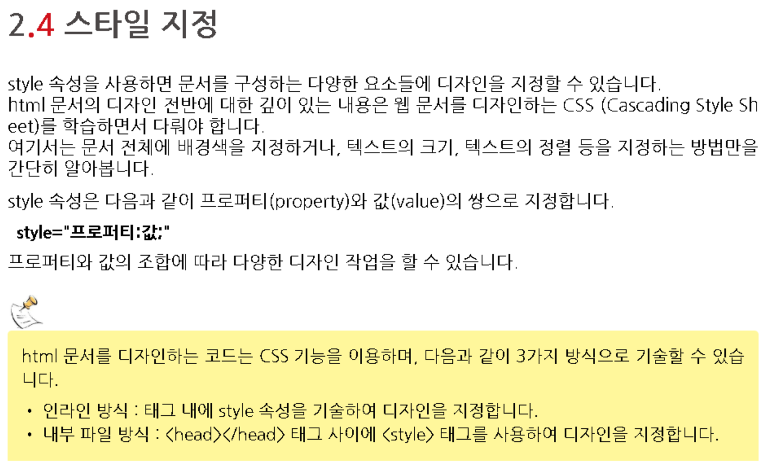

Slide 17
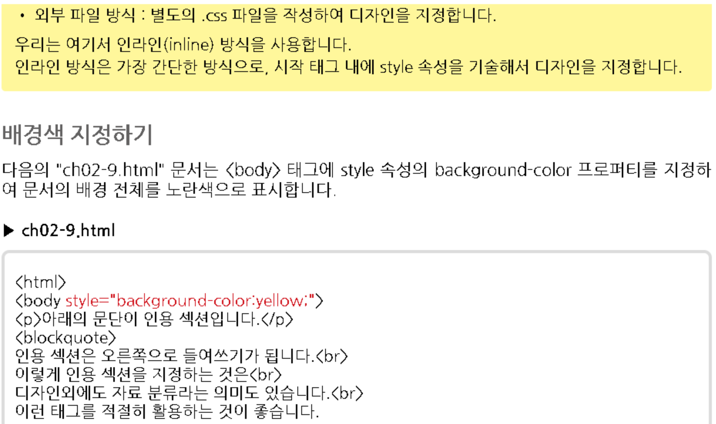
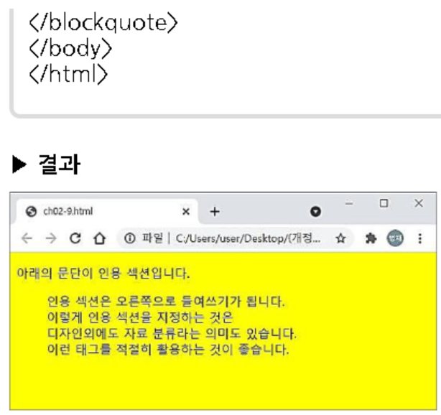

Slide 18
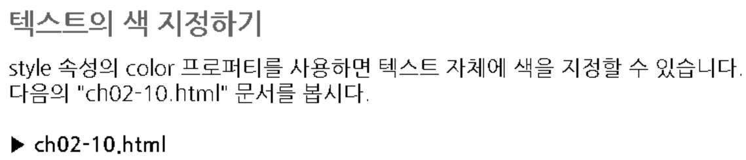
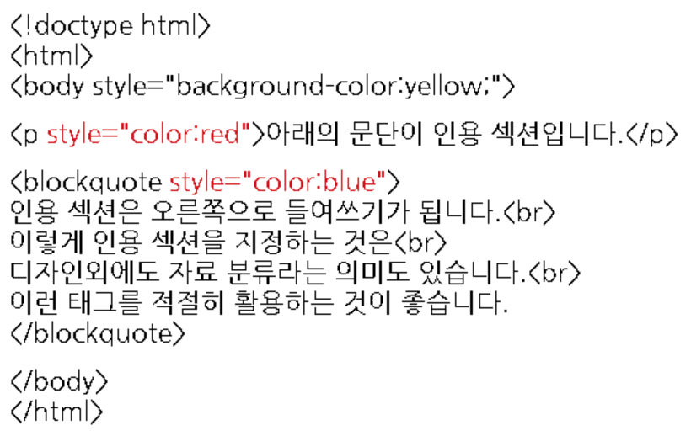
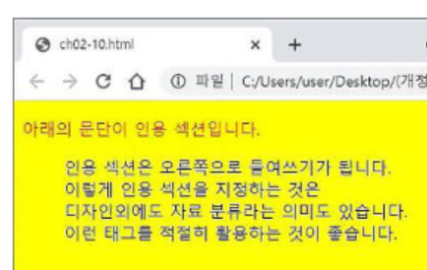

Slide 19
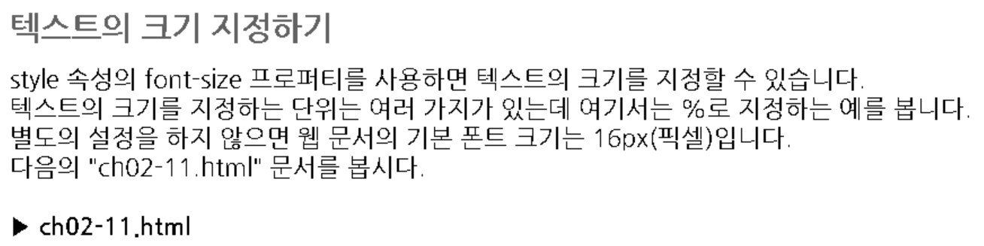
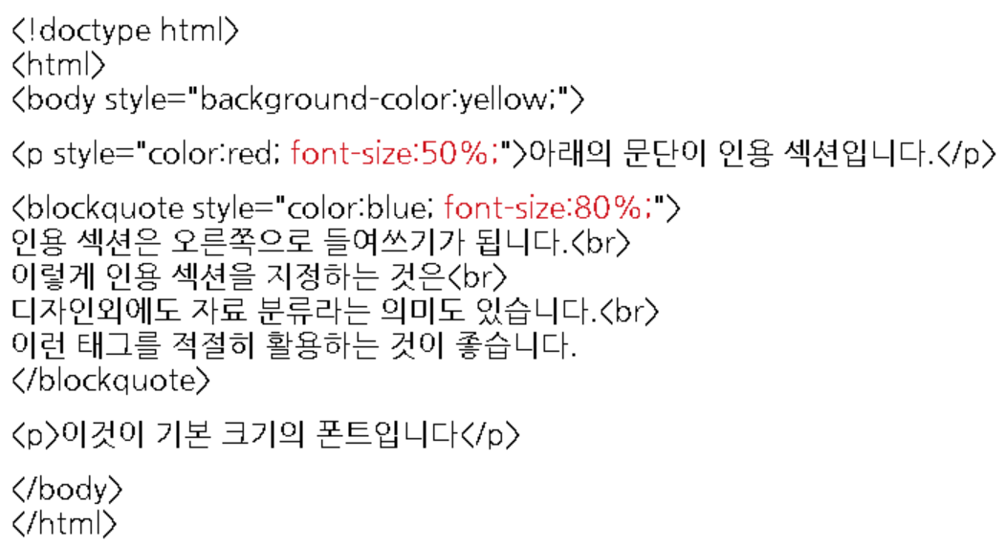
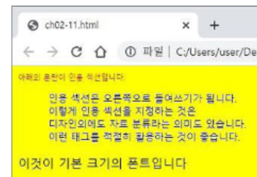

Slide 20
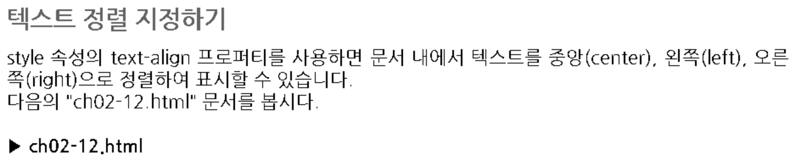
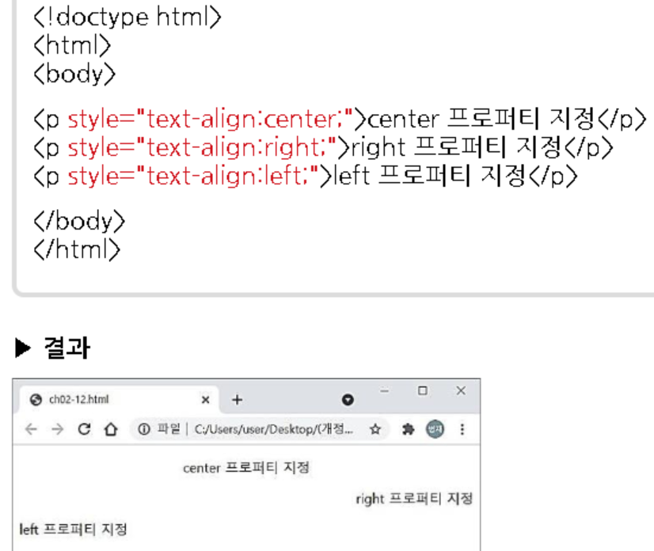

Slide 21
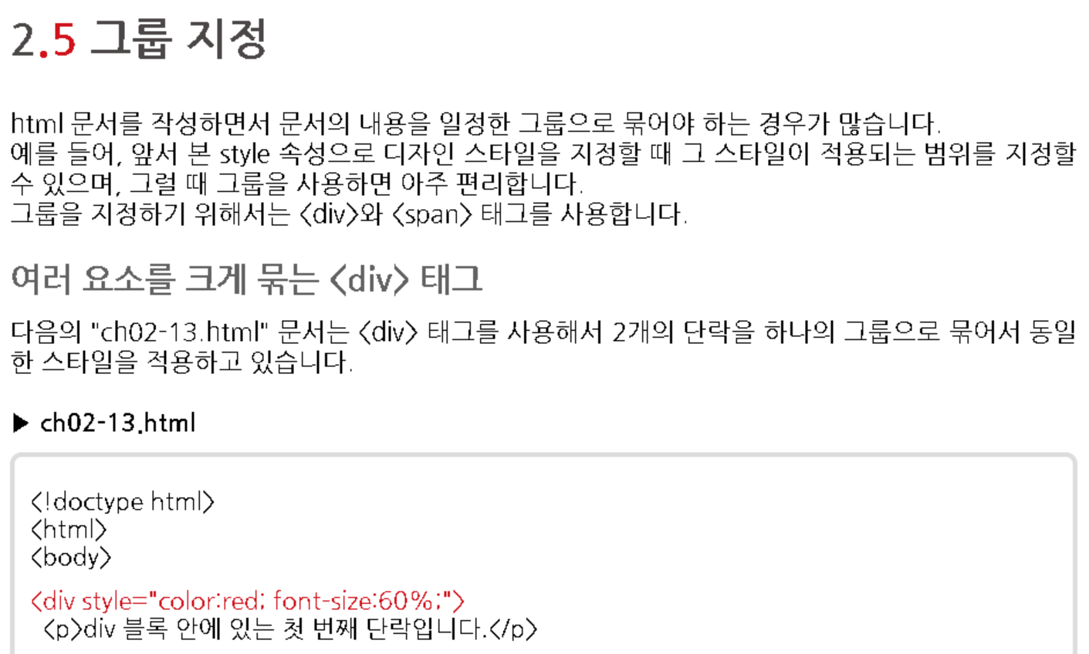
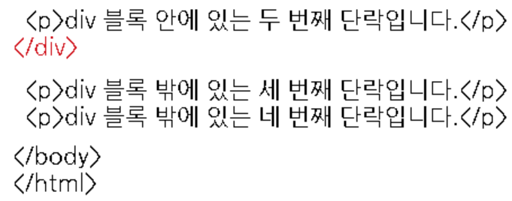
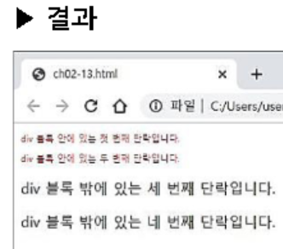

Slide 22
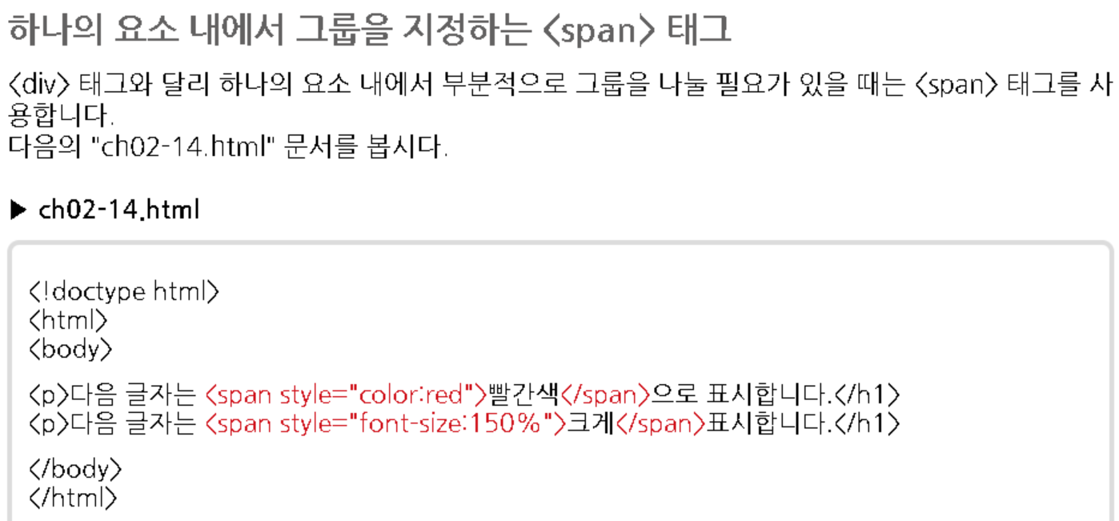
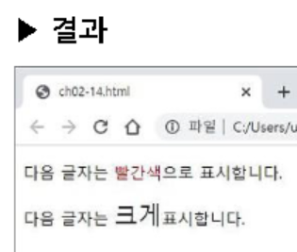

Slide 23
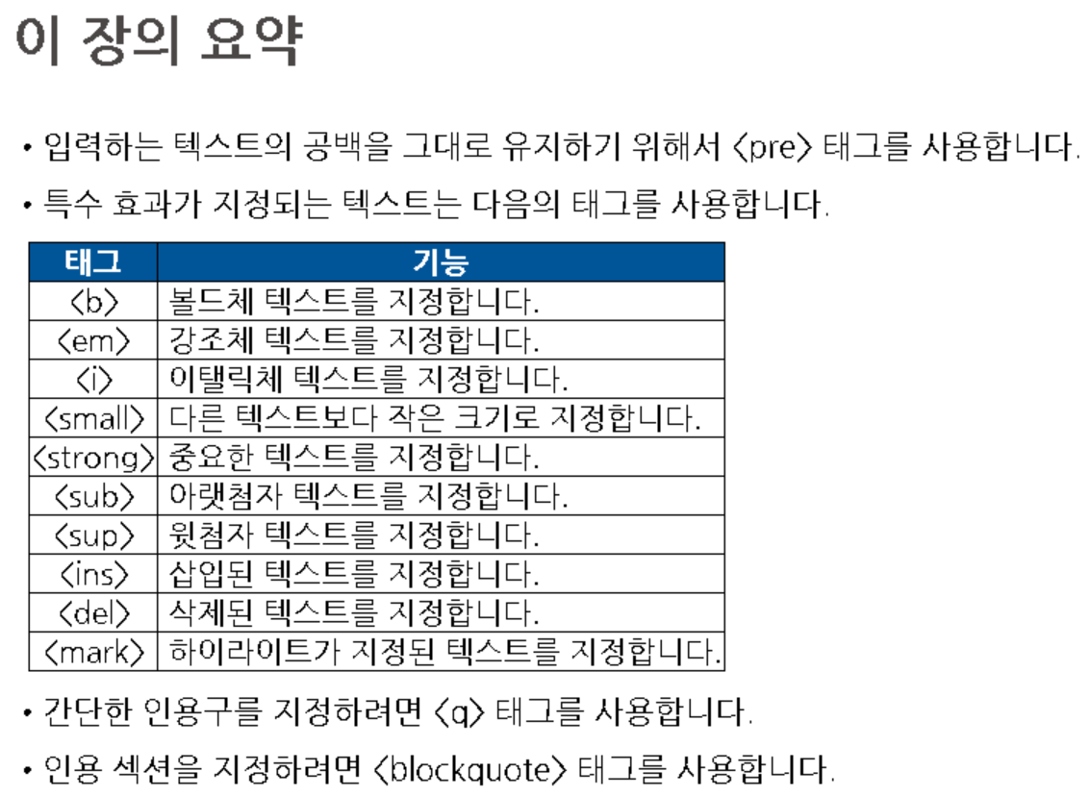

Slide 24
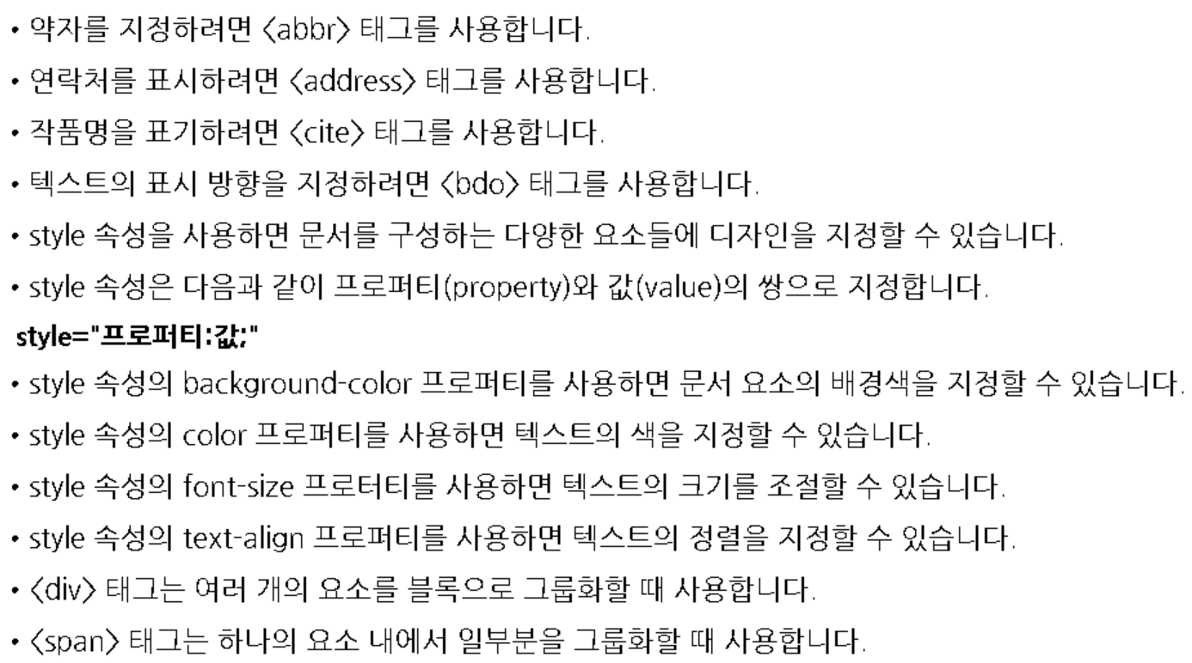

Slide 25
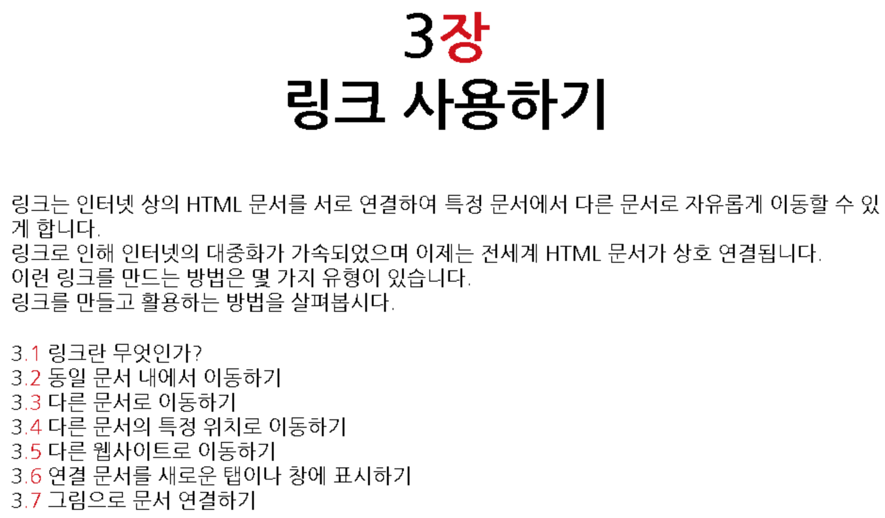

Slide 26
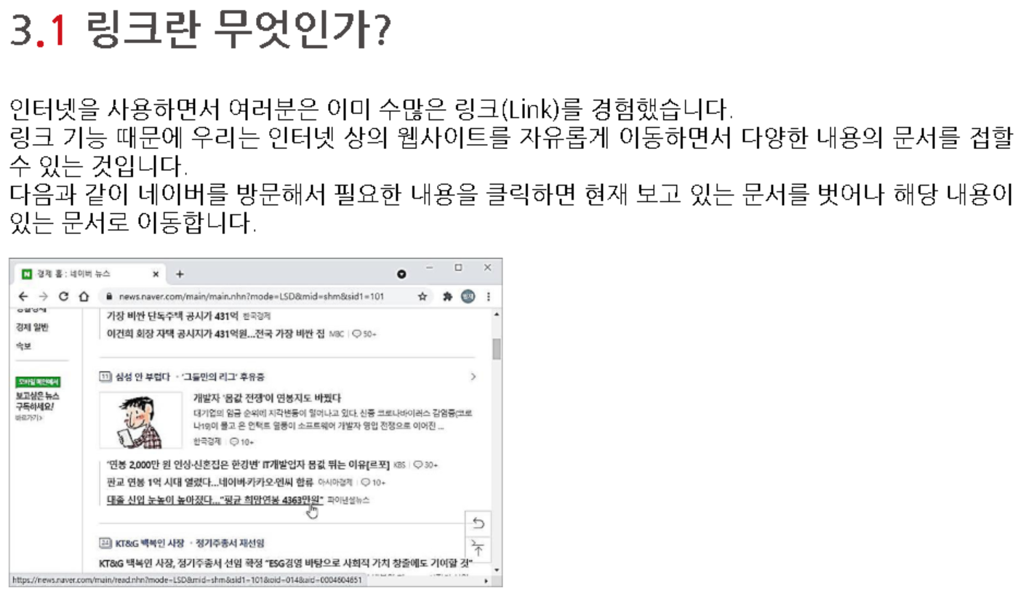

Slide 27
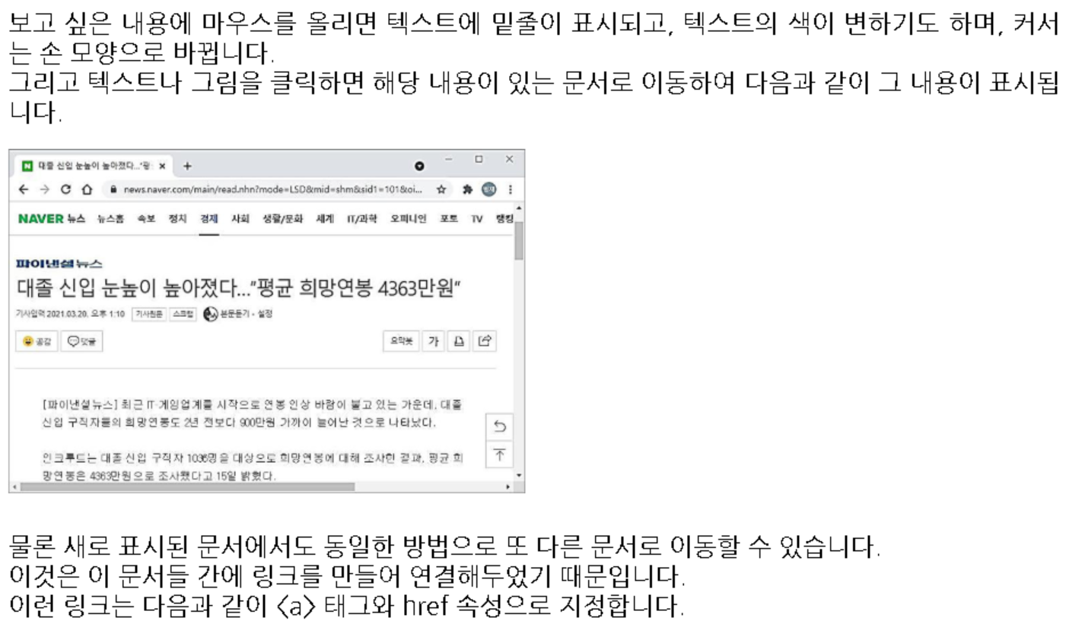

Slide 28
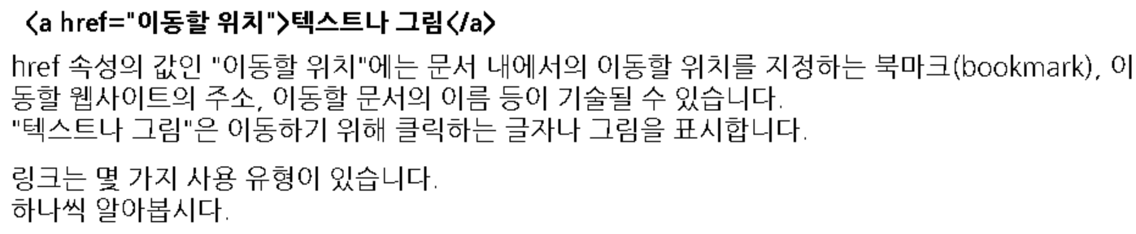

Slide 29
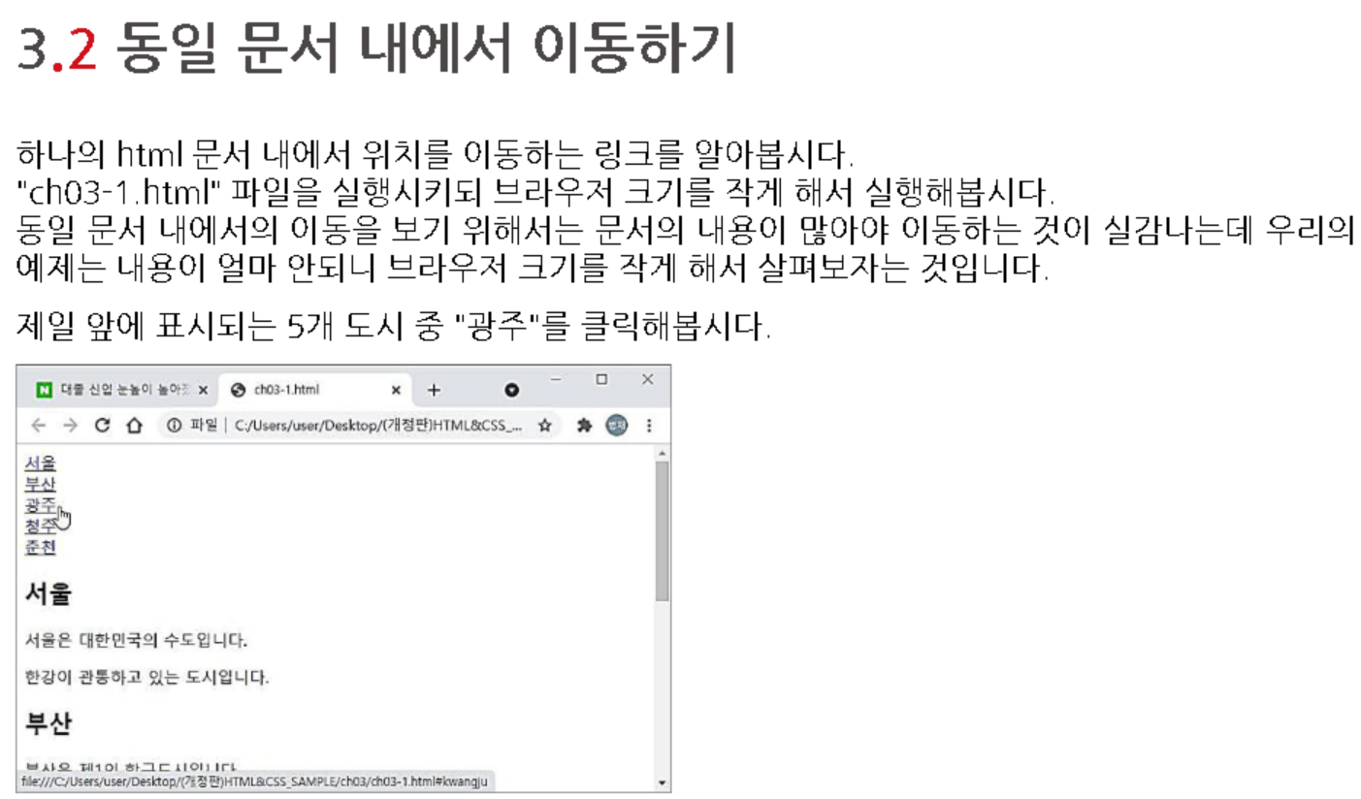

Slide 30
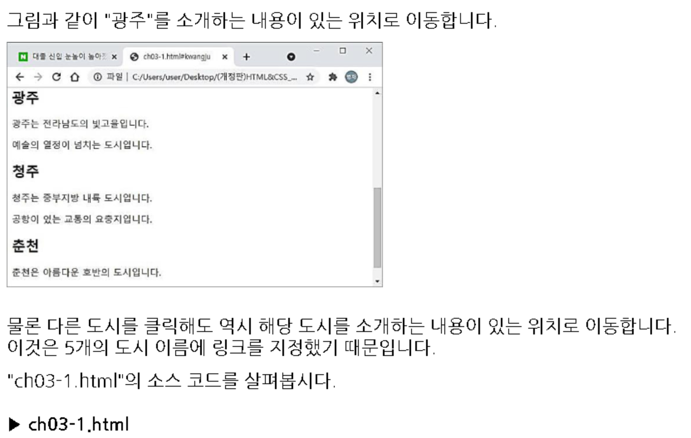

Slide 31
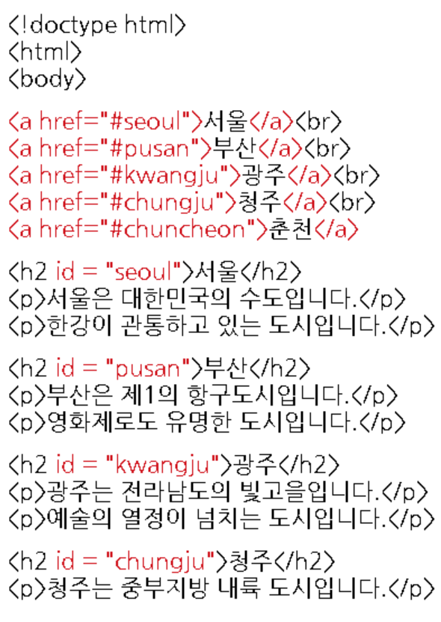
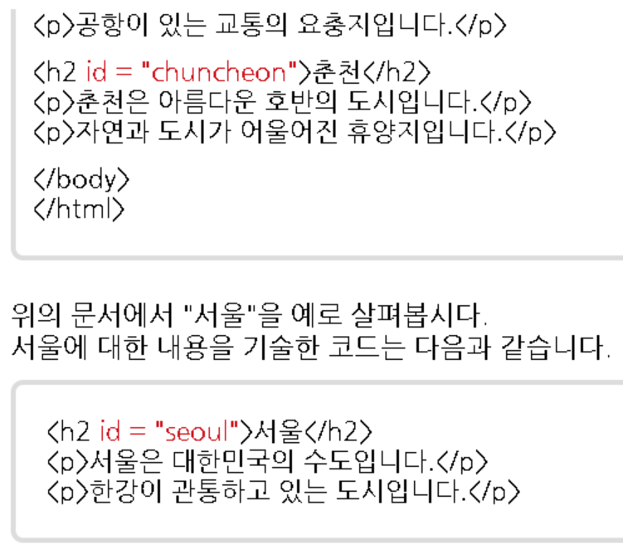

Slide 32



Slide 33


Slide 34



Slide 35






Slide 36


Slide 37


Slide 38





Slide 39



Slide 40



Slide 41


Slide 42


Slide 43


Slide 44


Slide 45


Slide 46


Slide 48


Slide 49


Slide 50



Slide 51



Slide 52


Slide 53


Slide 54


Slide 55



Slide 56


Slide 57


Slide 58


Slide 59




Slide 60


Slide 61


Slide 62


Slide 63


Slide 64


Slide 65


Slide 66


Slide 67


Slide 68


Slide 69


Slide 70



Slide 71


Slide 72


Slide 73


Slide 74


Slide 75



Slide 76


Slide 81



Slide 82
HTML
not yet…

Slide 83


